Slide 1
Very first hands on Arduino and its connection to Python through PySerial (to have an excuse to play with electronics here...)
ELISABETH ORTEGA-CARRASCO, PHD.
Pyladiesbcn meeting, april 2018

Slide 2
About me: science, tecH and sports passionate
Bullet point CV:
Scientific consultant and C++ developer (and commercial, marketing, trainer, web developer, coach, coffe maker…) in Lead Molecular Design.
BsC. Chemistry, MsC and PhD. Computational Chemsitry.
Graduate in Computer Science.
Contact details:
ortega.elisabeth@gmail.com
@draentropia (twitter)
Elisabeth Ortega Carrasco (LinkedIn)
https://github.com/draentropia/
www.entropiapps.com

Slide 3

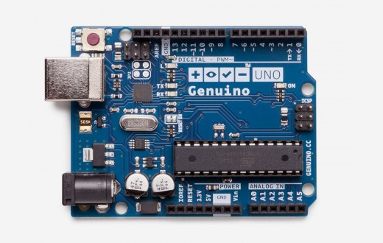
ARDU…what???
By definition: Arduino is an open-source electronics platform based on easy-to-use hardware and software.
Reset button
Digital input/output
USB port
Power LED
Microcontroller ATmega
Power connector
Analog input
Power
input
Notes:
Atmega 32KB memoria , 0.5KB son del bootloader

Slide 4
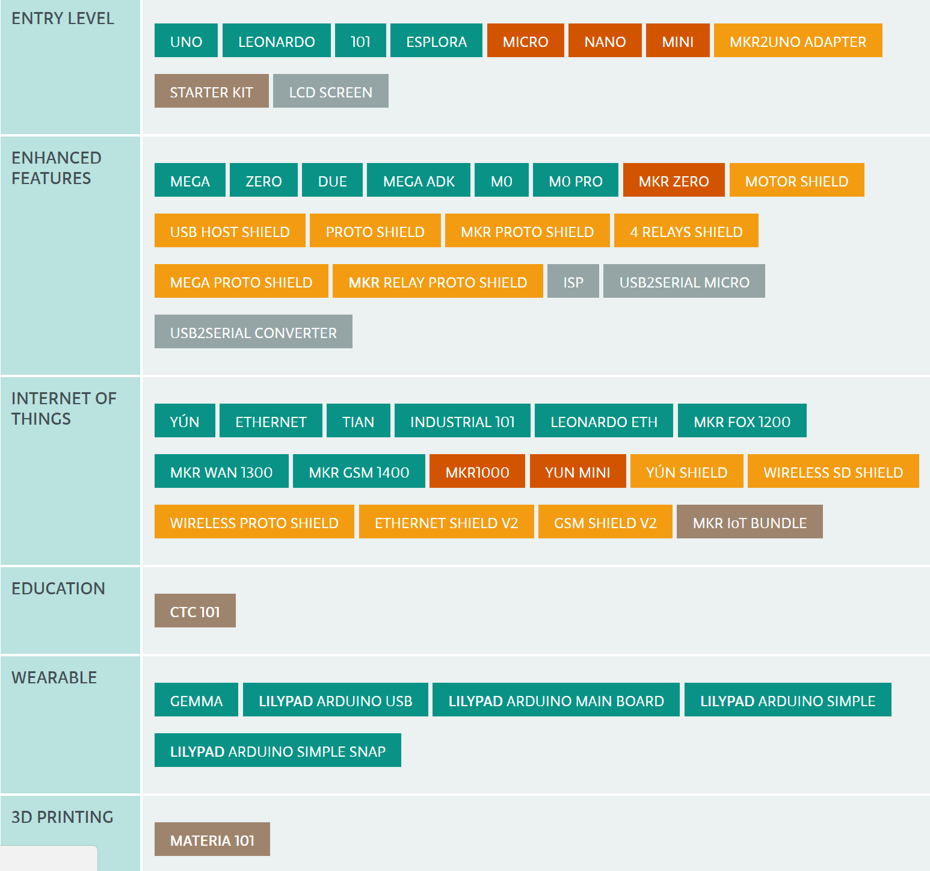
ARDUino hardware
4
https://www.arduino.cc/en/Main/Products

Slide 5
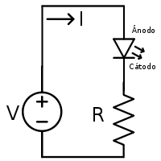
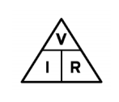
Very basic principles of electronics (I)
Ohm’s Law:
V = I x R
I (A): intensity (current) is the quantity of electric charge that travels along the circuit.
V (V): voltage is the difference in energy between two points of the circuit.
R(Ω): resistance is the tendency to resist the flow of charge.

Slide 6

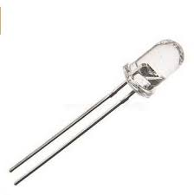

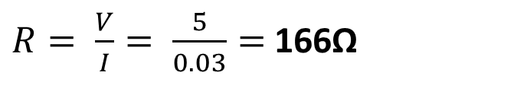
Very basic principles of electronics (II)
An example of why we need to know Ohm’s law:
V = 5 V (Arduino board)
I = 30 mA (0,03 A) (LED máximum supported current)
R ?
R > 116Ω
$R= \frac{V}{I}= \frac{5}{0.03}=$166Ω
R >> 116Ω
R < 116Ω

Slide 7
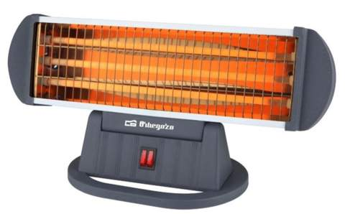
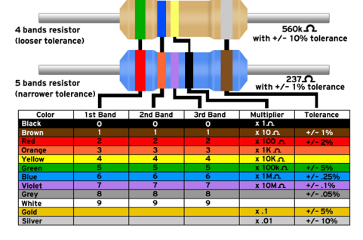
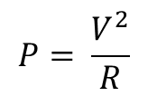
about resistors
Resistors transform electricity into heat:
They are self explanatory:
$$P= \frac{V^{2}}{R}$$
P (Arduino resistors ) = 0.25W
$$V=\sqrt{P∗R}=\sqrt{0,25∗220}=7,4 V$$
V < 7,4
V > 7,4
7

Slide 8

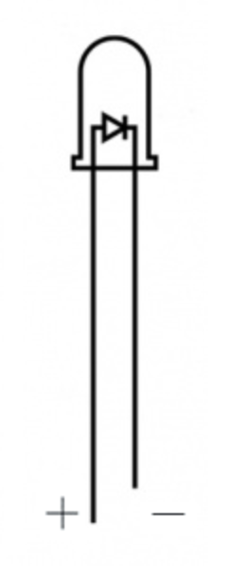
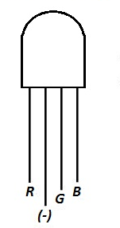
about LEDs
In Arduino Starter Kit
LEDs transform electricity into light:
Single color LED
States: ON / OFF
RGB LED
States: [0,255] on each

Slide 9
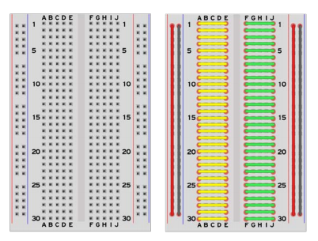
The breadboard / protoboard

Slide 10
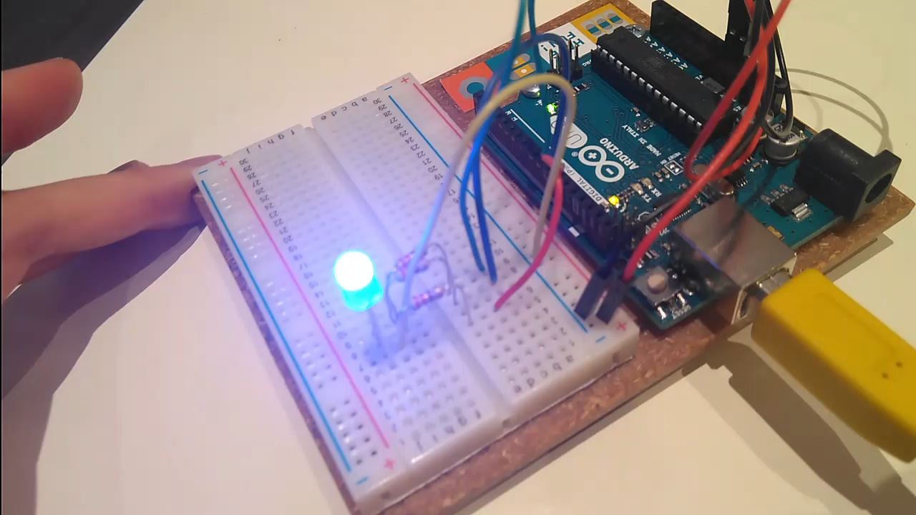
Hands on (i): build a led circuit

Slide 11
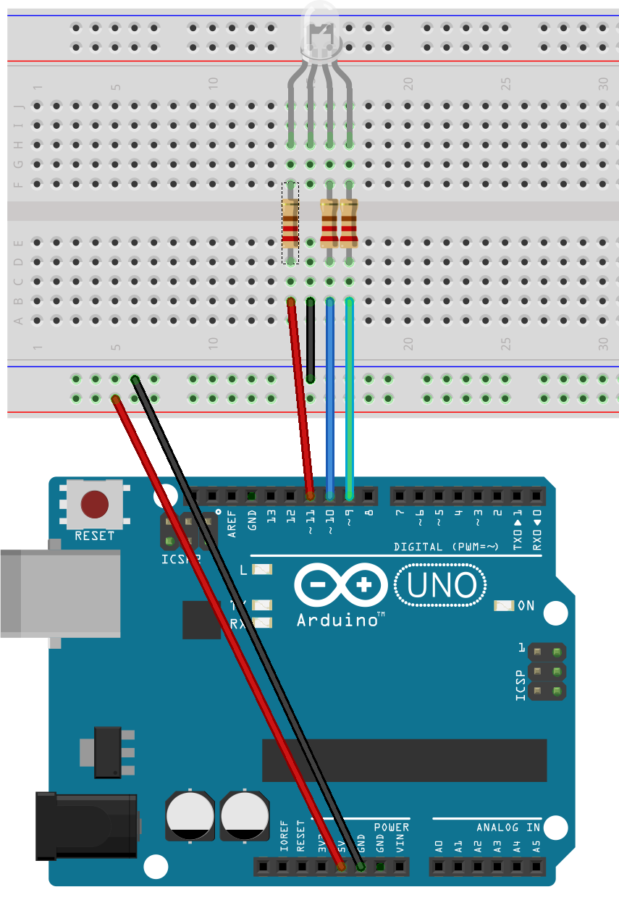
Hands on (i): build a led circuit
RGB LED common cathode
3x 220Ohm resistors
4 wires
Arduino UNO board

Slide 12
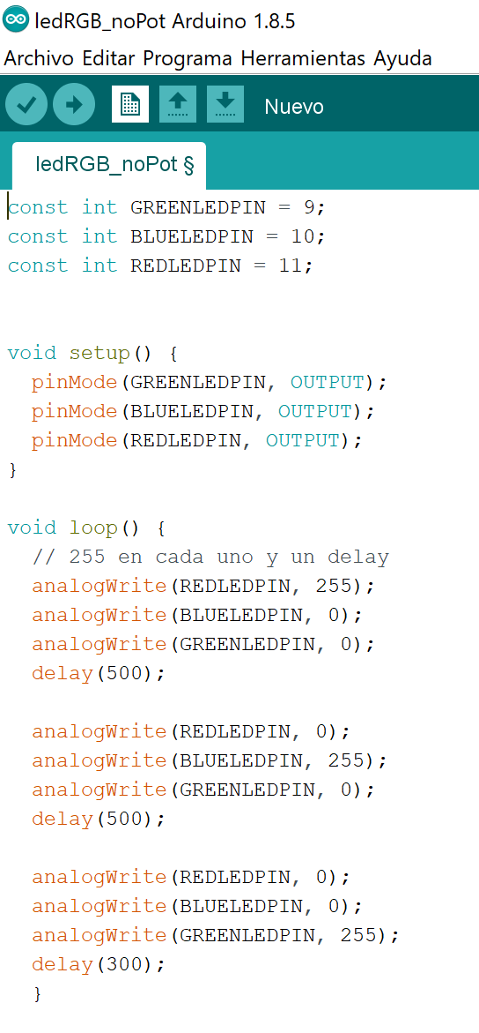
Hands on (i): build a led circuit
Code: ledRGB_noPot

Slide 13
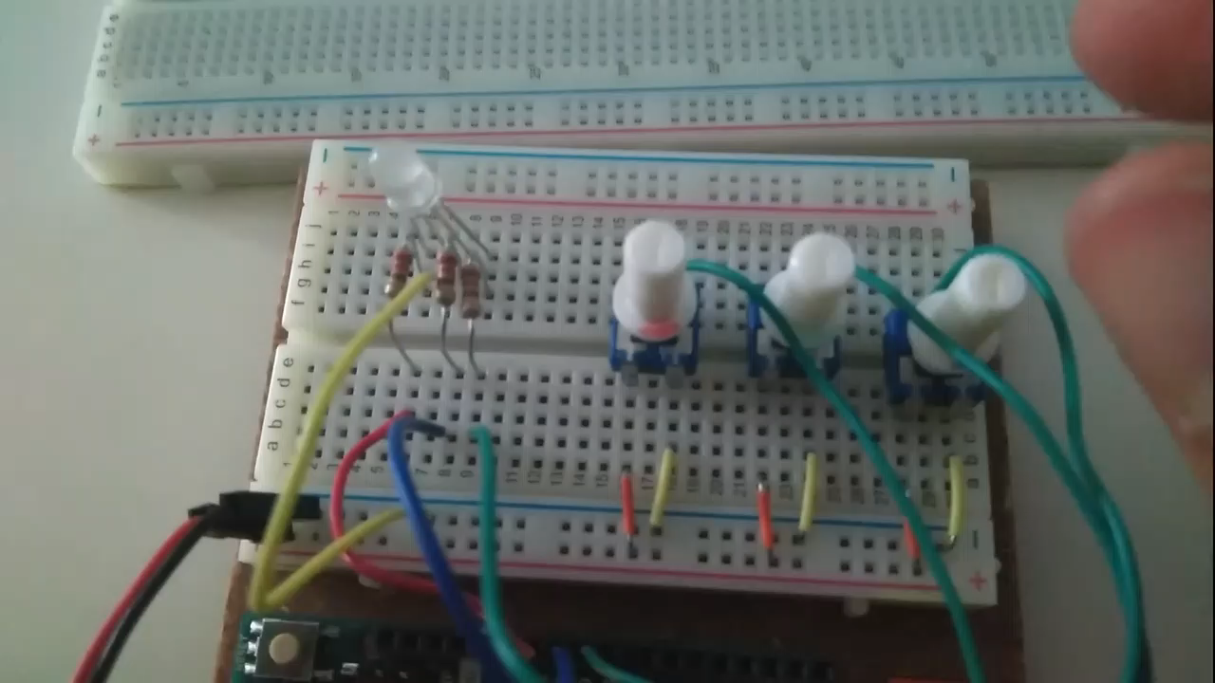
Can we control the color and the shine of the led?

Slide 14
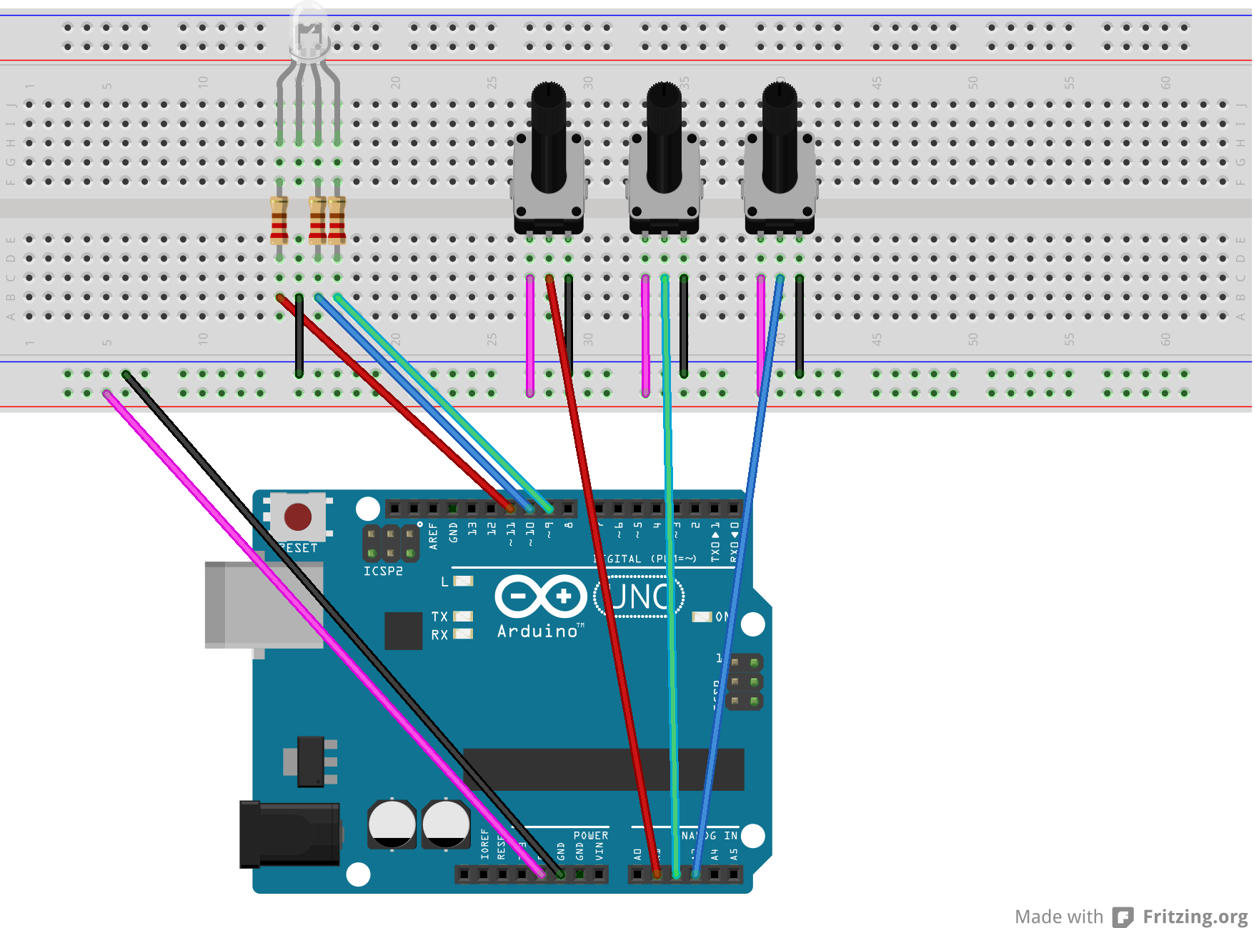
Hands on (Ii): controlling the rgb led
RGB LED
3 potentiometers
3x 220Ohm resistors
13 wires
Arduino UNO board

Slide 15
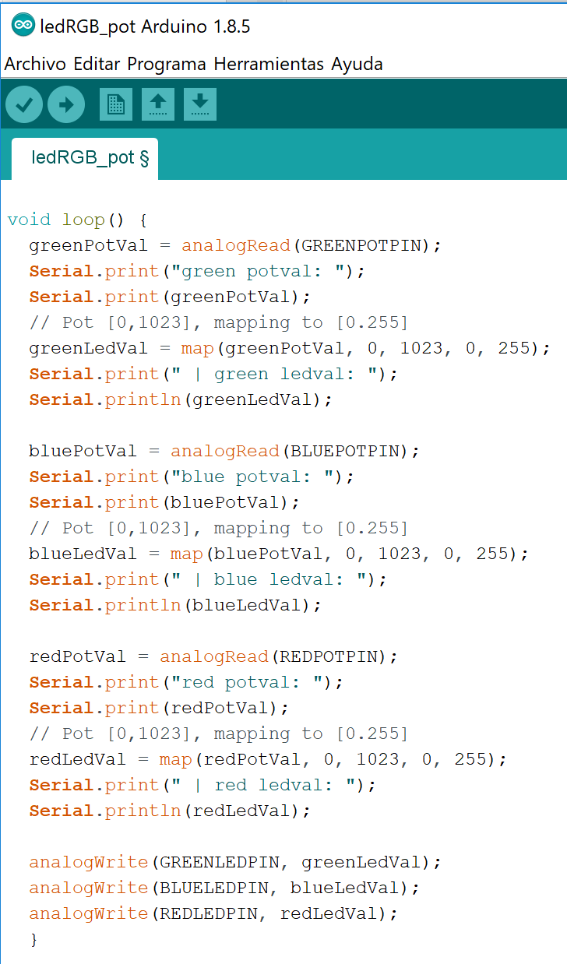
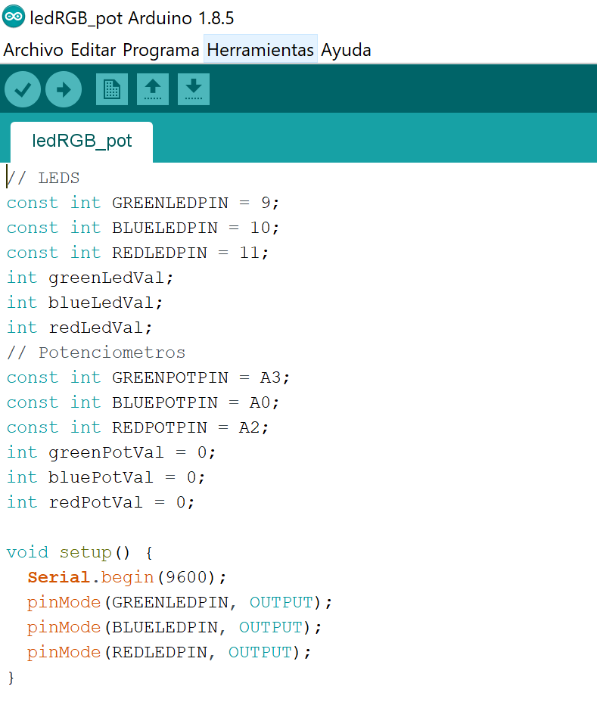
Hands on (Ii): controlling the rgb led
Code: ledRGB_pot

Slide 16


WHY WE ARE NOT TALKING ABOUT PYTHON?

Slide 17
connect Arduino to Python through pyserial
PySerial?
Allows communication through serial ports
USB: Universal Serial Bus
Example:
Information transfers one bit at time
# http://wiki.elhacker.net/programacion/python/pyserial
import pyserial ser = serial.Serial('/dev/ttyS1', 9600) # Port and bauds (symbols/s) while 1: print(ser.readline())

Slide 18
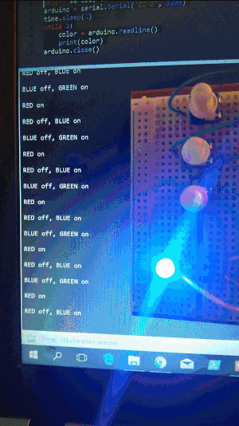
Read data from arduino
Code: example1
Arduino code:
//Initialize constants
void setup() {
Serial.begin(9600);
pinMode(REDPIN, OUTPUT);
void loop() {
analogWrite(REDPIN, 255);
Serial.println(“RED ON”);
delay(1500);
Python code:
import serial, time
arduino = serial.Serial('COM3', 9600)
time.sleep(2)
while 1:
color = arduino.readline()
print(color)
arduino.close()

Slide 19
write data to arduino
Code: example2
Arduino code:
void loop() {
while (Serial.available()>0) {
red = Serial.parseInt();
if (Serial.read() == '\n') {
Serial.println("Data read ");
red = constrain(red, 0, 255);
analogWrite(REDLEDPIN, red);
}
}
}
Python code:
import serial, time
arduino = serial.Serial("COM3", 9600)
time.sleep(2)
red = 255
green = 0
blue = 0
colorLED = str(red) + ',' + str(green) + ',' + str(blue) + '\n'
print(colorLED)
arduino.write(colorLED.encode('ascii'))
arduino.close()

Slide 20
Your turn…

Slide 21
Hands on!
Workshop code in: https://github.com/pyladies-bcn/pyserial
If I’m a youngling (level 0):
Ask RGB colors to the user using raw_input(). -> example 2 code
If I’m a padawan (level 1):
Build a color dictionary and ask the color by its name, not it’s code. -> example 2 code
If I’m a Jedi Knight (level 2):
Play with time.sleep() command to build color sequences. -> example 2 code
Get the value of potentiometers and print it on the screen. -> example 1 code
If I’m a Jedi Master (level 3):
Do a small webapp (flask, django, etc…) to ask RGB values from a webpage. -> example 2 code

